Slide 1
Basra University
College of Education
Dept. of Counseling Psychology
year 2nd
The Readings of Counseling
Dr. Amal A. Naeem Almanssouri

Slide 2
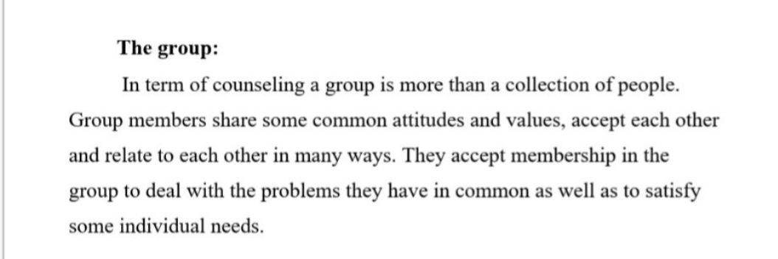
The group counseling

Slide 3
The group counseling

Slide 4
The group counseling

Slide 5
The group counseling

Slide 6
The group counseling

Slide 7
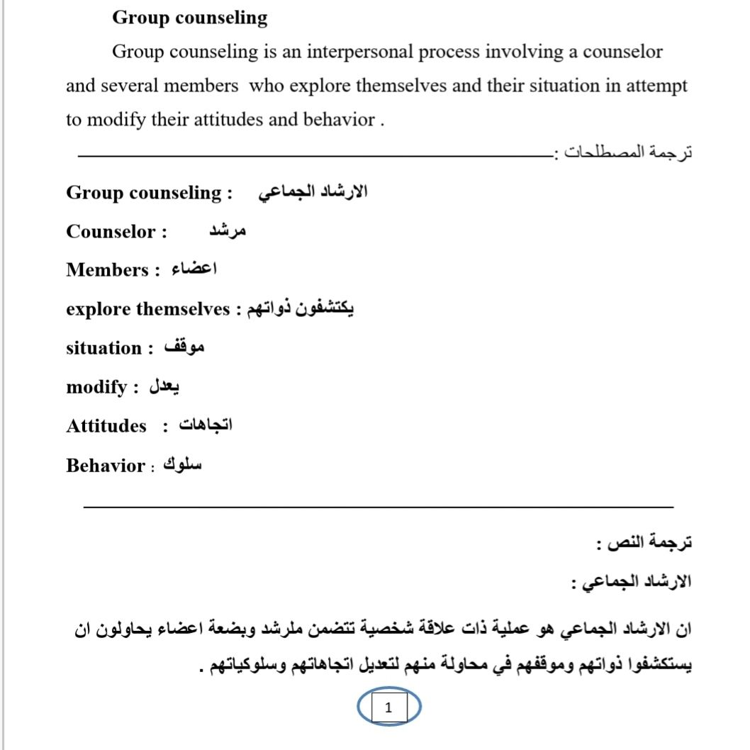

Slide 8
Preparation for the group:
1. The sitting:
The counselor must locate appropriate place for the group to meet and establish policy about the duration of the group. The duration of each session, admission of new members and the size of the group. Group session may be held in any setting that affords some degree of comfort as well as privacy, and is free from distractions.

Slide 9
Preparation for the group:
ترجمة المصطلحات: ـــــــــــــــــــــــــــــــــــــــــــــــــــــــــــــــــــــــــــــــــــــــــ
Preparation : اعداد / تهيئة
The sitting : الوضعية
session Group : الجلسة الجماعية
comfort : راحة
privacy : الخصوصية
distractions : مشتتات

Slide 10
Preparation for the group:
2. Size:
A consensus of the literature, although mostly not based on research, suggests that the ideal size for group in counseling seven to eight members with arrange from five to ten.

Slide 11
Preparation for the group:
ترجمة المصطلحات: ـــــــــــــــــــــــــــــــــــــــــــــــــــــــــــــــــــــــــــــــــــــــــ
Literature : الادبيات
ideal size : الحجم المثالي

Slide 12
Preparation for the group:
3. Selection:
A counselor can increase the chance of success within the group by careful selection of clients.
Client should be thoroughly screened so the counselor will under stand as much as possible about them. The counselor may wish to review a history of the client’s family background, childhood, adolescence and other developmental areas. It may be helpful to be acquainted with the Client’s medical history.

Slide 13
Preparation for the group:
Selection : اختيار
chance of success : فرصة بالنجاح
careful selection : اختيار دقيق
childhood :الطفولة
adolescence : المراهقة
medical history : التاريخ الطبي

